Slide 1
TRUCK Results: FCEV Targets
August 31, 2020

Slide 2
DOE Targets: FCEV Program
 | 2021 | 2027 | 2035 | 2050
Peak Efficiency | 64% | 66% | 68% | 72%
Cost ($/kW) | $148 | $111 | $80 | $60
Hydrogen storage cost ($/kWh) | $27 | $16 | $10 | $8
Hydrogen storage cost ($/usable H2)

Slide 3
Power ($/kW) Target
Interpolate?
Separate compared to base
For 7&8 sleep, day, and SU
 | 2021 | 2027 | 2035 | 2050
Peak Efficiency | 64% | 66% | 68% | 72%
Cost ($/kW) | $148 | $111 | $80 | $60
Hydrogen storage cost ($/kWh) | $27 | $16 | $10 | $8
Hydrogen storage cost ($/usable H2)
 | 2021 | 2027 | 2035 | 2050
Original Target ($/kW) | $148 | $111 | $80 | $60
New Target ($/kW) | $148 | $80 | $65 | $60
Difference ($ per kW) | 0.00 | $31 | $15 | $0
Fuel Converter Power (kW) | 302.58 | 298.68 | 294.73 | 277.28
Total Difference ($) | $0.00 | $9,259.08 | $4,420.95 | $0.00
Total Difference Including Markup | $0.00 | $13,888.62 | $6,631.43 | $0.00

Slide 4
Hydrogen Storage Cost ($/kWh) Target
Interpolate?
Separate compared to base
 | 2021 | 2027 | 2035 | 2050
Peak Efficiency | 64% | 66% | 68% | 72%
Cost ($/kW) | $148 | $111 | $80 | $60
Hydrogen storage cost ($/kWh) | $27 | $16 | $10 | $8
Hydrogen storage cost ($/usable H2)
 | 2021 | 2027 | 2035 | 2050
Original Target ($/kWh) | $27 | $16 | $10 | $8
New Target ($/kW) | $16 | $10 | $8 | $8
Difference ($ per kW) | $11 | $6 | $2 | $0
Fuel Storage Energy (kWh) | $3204 | $2778 | $2717 | $1770
Total Difference ($) | $ 36,621 | $16,668 | $5,434 | $0
Total Difference Including Markup | $ 54,932.58 | $ 25,002.00 | $ 8,151.00 | $0

Slide 5
Fuel Price Targets
Year | DOE Program Success Case | Sensitivity Scenario
2007 | 12.00 | 10
2008 | 12.00 | 10
2009 | 12.00 | 10
2010 | 12.00 | 10
2011 | 12.00 | 10
2012 | 12.00 | 10
2013 | 12.00 | 10
2014 | 12.00 | 10
2015 | 12.00 | 10
2016 | 11.50 | 10
2017 | 11.00 | 10
2018 | 10.50 | 10
2019 | 10.00 | 10
2020 | 9.50 | 10
2021 | 9.00 | 9
2022 | 8.50 | 8
2023 | 8.00 | 7
2024 | 7.50 | 6
2025 | 7.00 | 5
2026 | 6.88 | 5
2027 | 6.76 | 5
2028 | 6.64 | 5
Year | DOE Program Success Case | Sensitivity Scenario
2029 | 6.52 | 5
2030 | 6.40 | 4
2031 | 6.28 | 4
2032 | 6.16 | 4
2033 | 6.04 | 4
2034 | 5.92 | 4
2035 | 5.80 | 4
2036 | 5.68 | 4
2037 | 5.56 | 4
2038 | 5.44 | 4
2039 | 5.32 | 4
2040 | 5.20 | 4
2041 | 5.08 | 4
2042 | 4.96 | 4
2043 | 4.84 | 4
2044 | 4.72 | 4
2045 | 4.60 | 4
2046 | 4.48 | 4
2047 | 4.36 | 4
2048 | 4.24 | 4
2049 | 4.12 | 4
2050 | 4.00 | 4

Slide 6
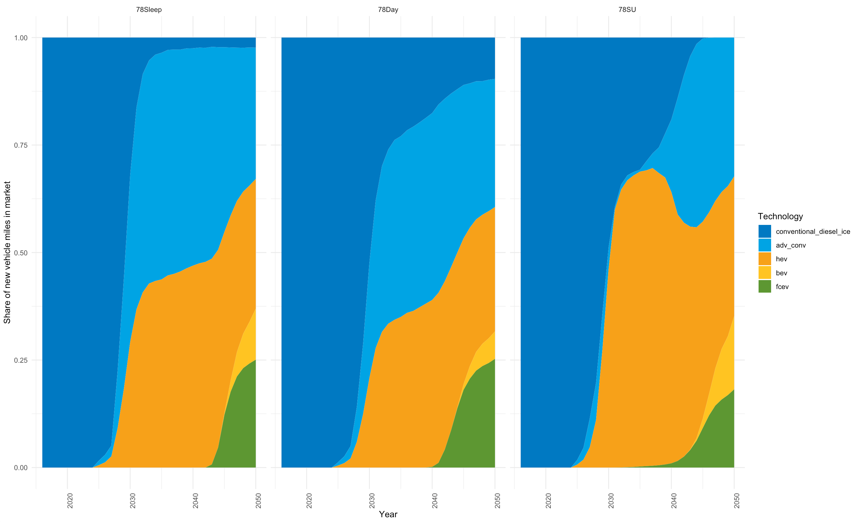
DOE Program Success Case
Notes:
Straight from Alicia’s TRUCK model

Slide 7
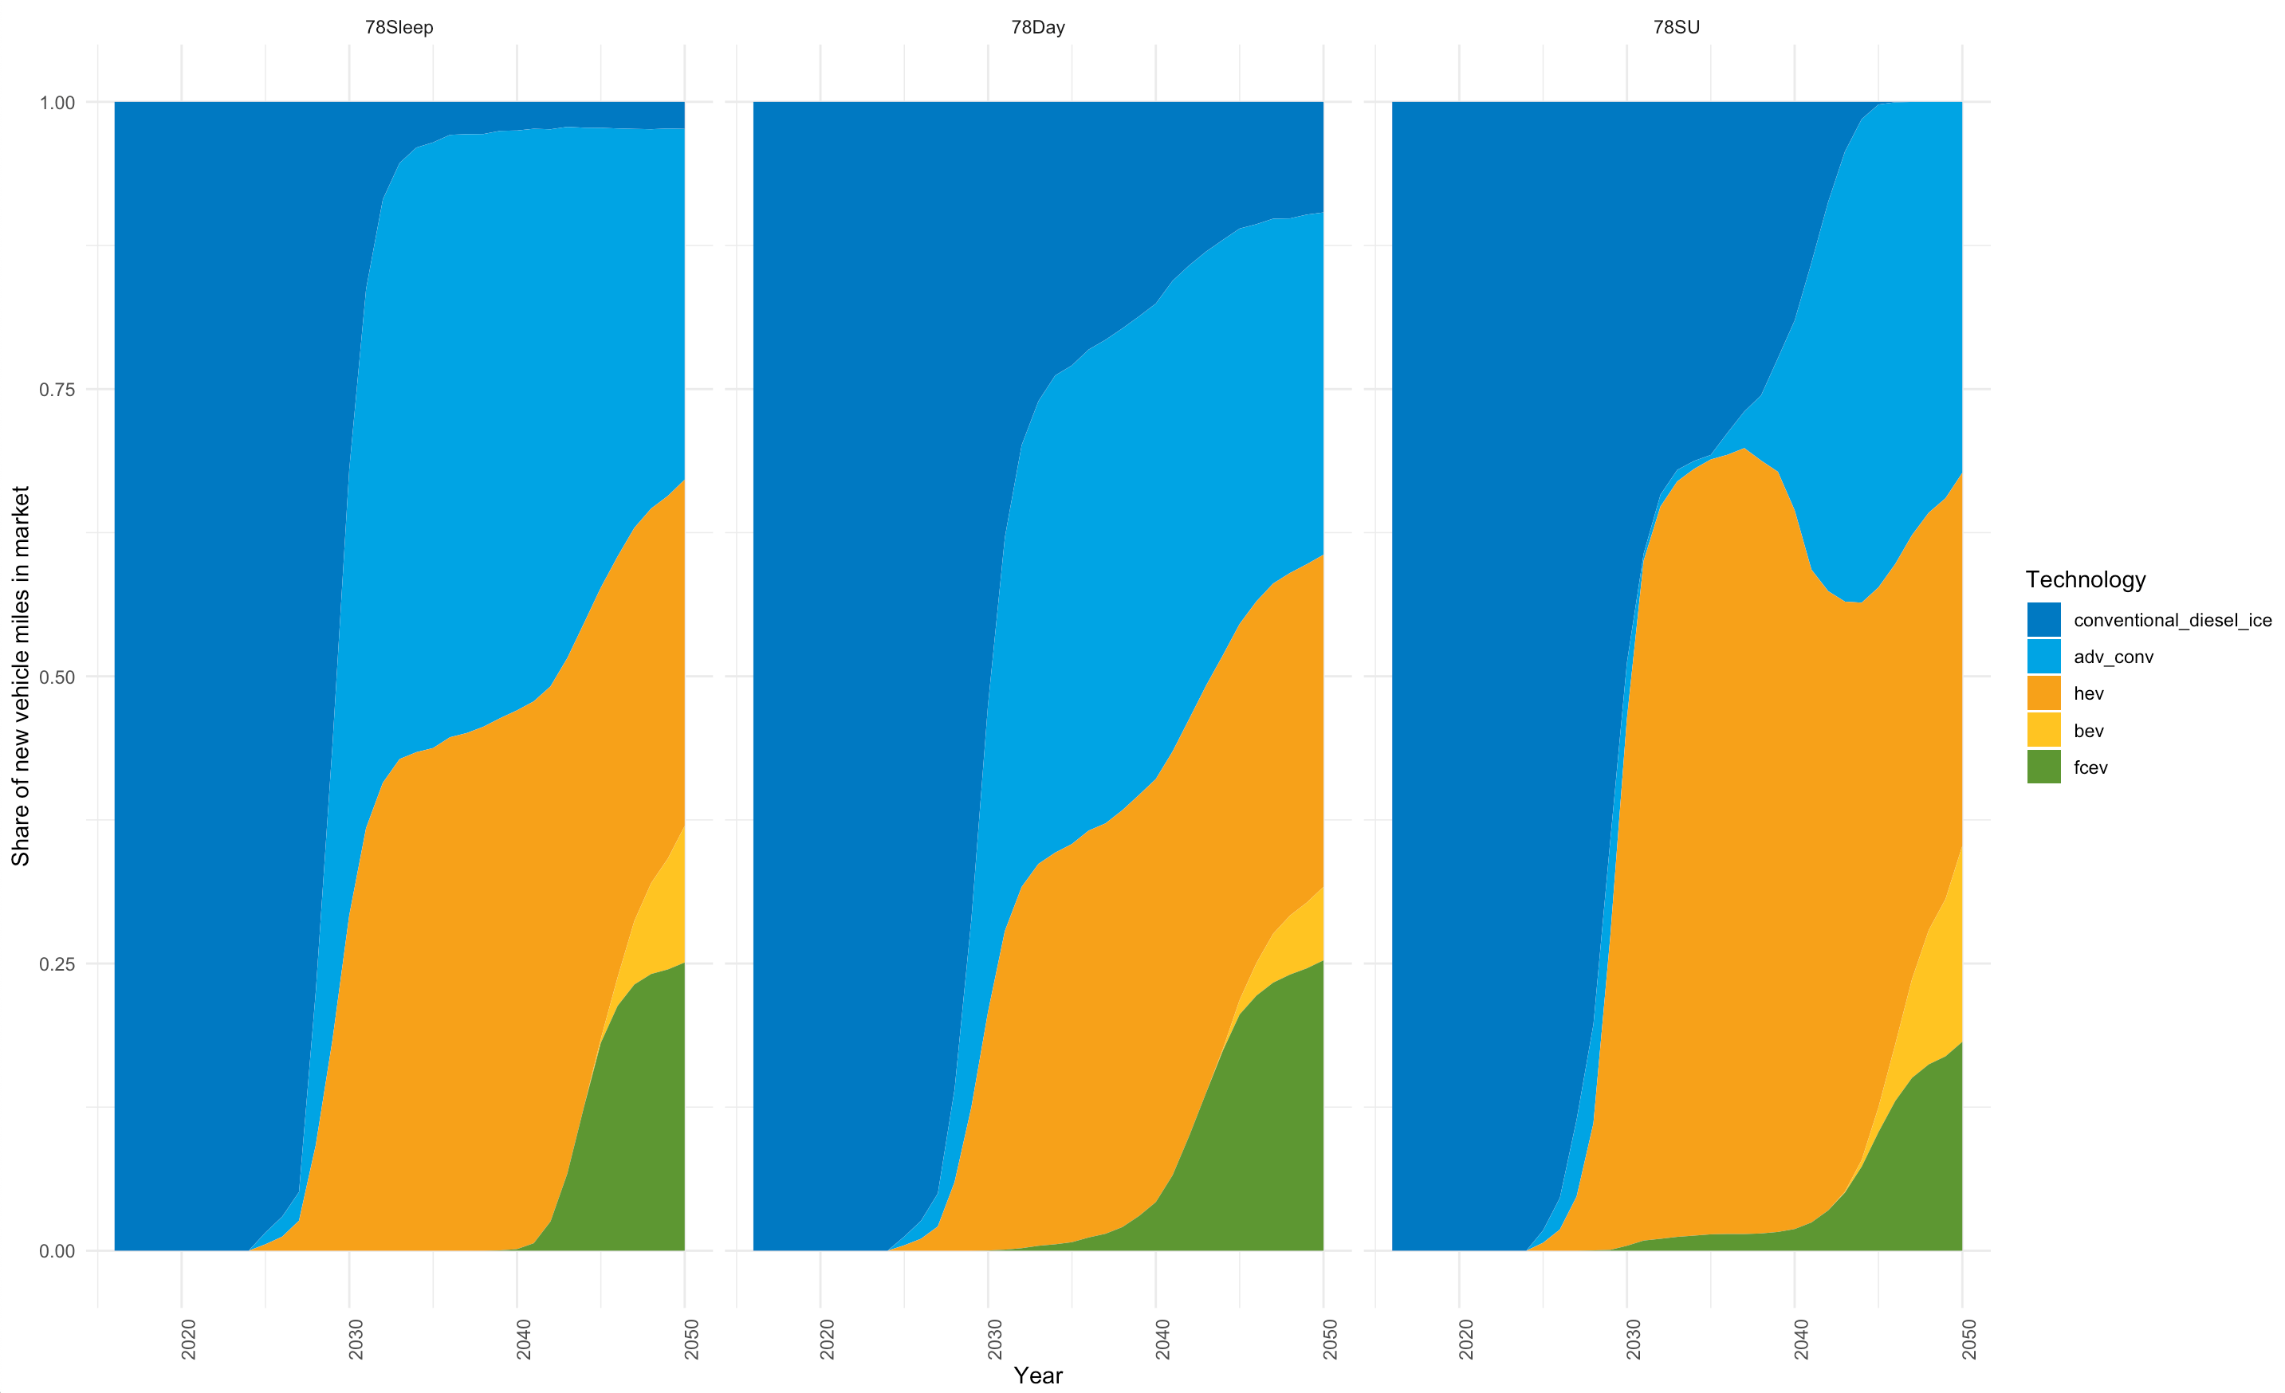
Only Altering Fuel Prices Target

Slide 8
Only Altering Power Target ($/kW)
DOE program success fuel prices
DOE program success kWh

Slide 9
Only Altering Hydrogen Storage Cost Target ($/kWh)

Slide 10
Altering All Three Targets at Once

Slide 11
Line Plot Three Different Scenarios

Slide 12
Appendix

Slide 13
Alicia TRUCK Levers:
There is inconsistent treatment in the TRUCK file for the “indifference” function. We never really exercised or vetted this, so I recommend you turn it “off” as we discussed. I set the parameters to $5 / $5 and make sure the incremental cost is never that low (or negative).
This version has a TRUE/FALSE flag on the FA constraint; see FuelAvail tab. I’ve turned it off for class 7&8 but plan to keep it on for class 4-6.
Still need to update the H2 price. – MG did? Should I work off the one with the newer fuel prices or Alicia’s?

